Slide 1
Voice to Text Converter (Android App)
Prepared By:
Fenil Bhanavadiya (16IT006)
Naresh Chillur (16IT016)

Slide 2
OUTLINE
Introduction
Benefits of Speech to Text
Snapshot
Limitations
Future Work

Slide 3
Introduction
Android comes with an inbuilt feature voice to text through which you can provide voice input to your app.
With this you can add some of the cool features to your app like adding voice navigation(Helpful when you are targeting disabled people) filling a form with voice input etc.
In the background how voice input works is, the speech input will be streamed to a server, on the server voice will be converted to text and finally text will be sent back to our app.

Slide 4
Benefits of Voice to Text
Ease of communication – No more illegible handwriting
Quick document turnaround
Flexibility to work in or out of the office
Time saved with increased efficiency and less paper work
Tedious jobs can be streamlined and simplified
Fewer errors – provides an accurate and reliable method of documentation
Workflow visibility – enabling easier management of priorities and turnarounds.

Slide 5
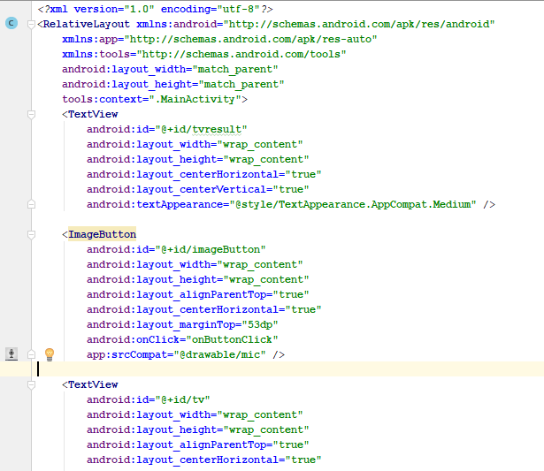
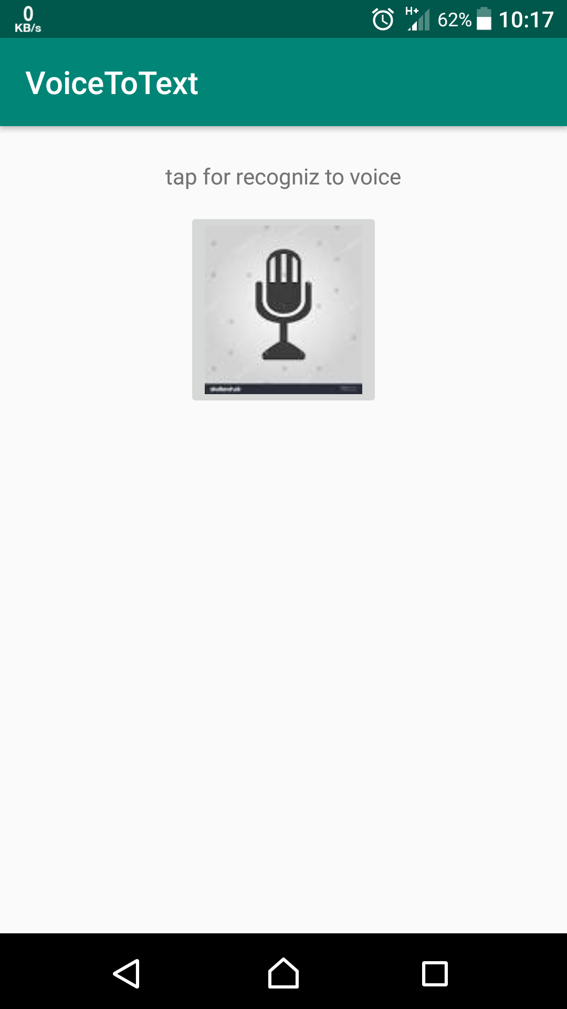

Slide 6
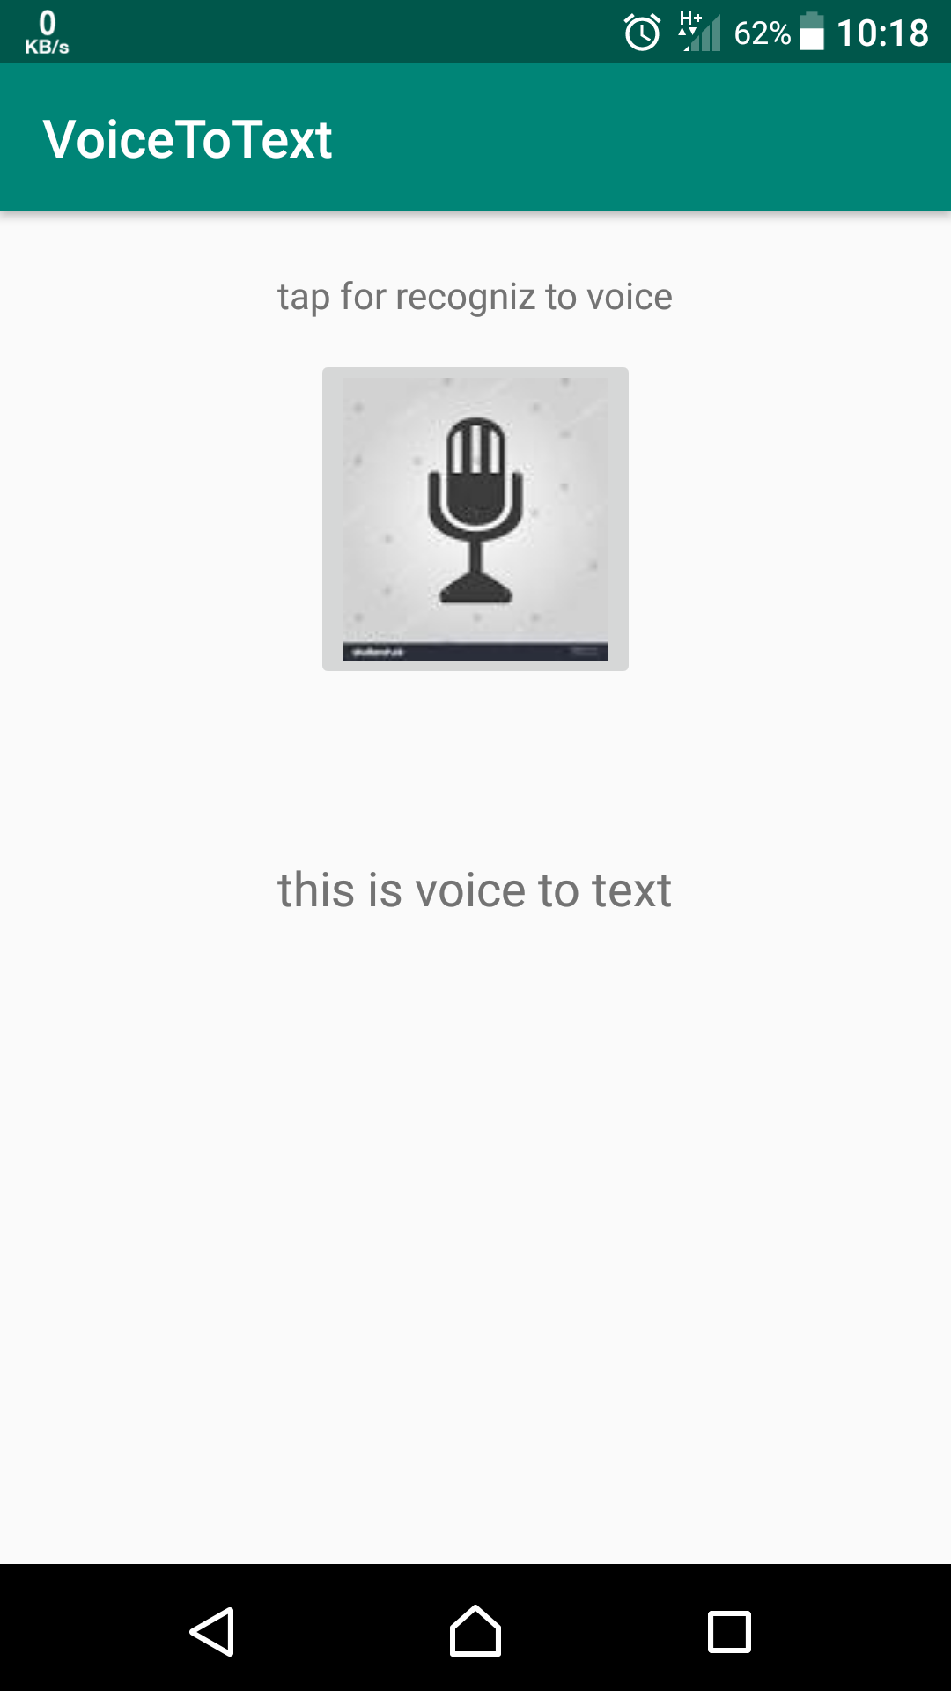
OUTPUT

Slide 7
Limitations
Lack of Accuracy and Misinterpretation
Accents and Speech Recognition
Physical Side Effects

Slide 8
Future Works
Instead of opening the application manually we are going to trigger the application automatically when the call is established.
We will develop the application like an interactive call based messaging application.
To implement in Gmail API.
Implement App UI more Attractive.

Slide 9
References
https://developer.android.com/studio/
https://www.techwalla.com/articles/the-disadvantages-of-voice-recognition-software
https://www.youtube.com/

Slide 10
THANK YOU

